Slide 1
SUTAS

Slide 2
Introduction
SUTAS is the Sungard Unified Test Automation System
SUTAS has been developed to enable deliberate and repeated tests of the infrastructure components at the deepest levels
SUTAS supports the product engineering goal to leverage automated tests to repeatedly and thoroughly test multiple dimensions of solutions and infrastructure, including:
Functional testing
Regression testing
Negative testing
Fault injection testing
Performance, Scalability, Durability testing
User Interface testing
Infrastructure readiness testing
Acceptance and Deployment testing
Sungard Availability Services Confidential

Slide 3
What is SUTAS ?
Sungard Unified Test Automation System is an automation framework based on Python and Robot Framework
Capable of driving tests written in Python, Powershell, Selenium, etc - expandable
End-to-End complete Testing framework for testing infrastructure
Interface to the all the Project tracking & Communication tools we use including Jira, Slack, Microsoft Teams, Email, Jenkins, Artifact repository, Postgress, etc

Slide 4
Why Robot Framework ?
Good open source automation engine
Easy to write test cases in english language, no need of high level language knowledge
Easy to write new ROBOT custom modules using python language
Test cases can be written in Robot IDE, or in simple Notepad
Well drafted html reports for the test suites
Note – we very deliberately did not touch the ROBOT open source
SUTAS is built on top of it, not in it
Allows us to rapidly upgrade to new versions
Allows IP separation

Slide 5
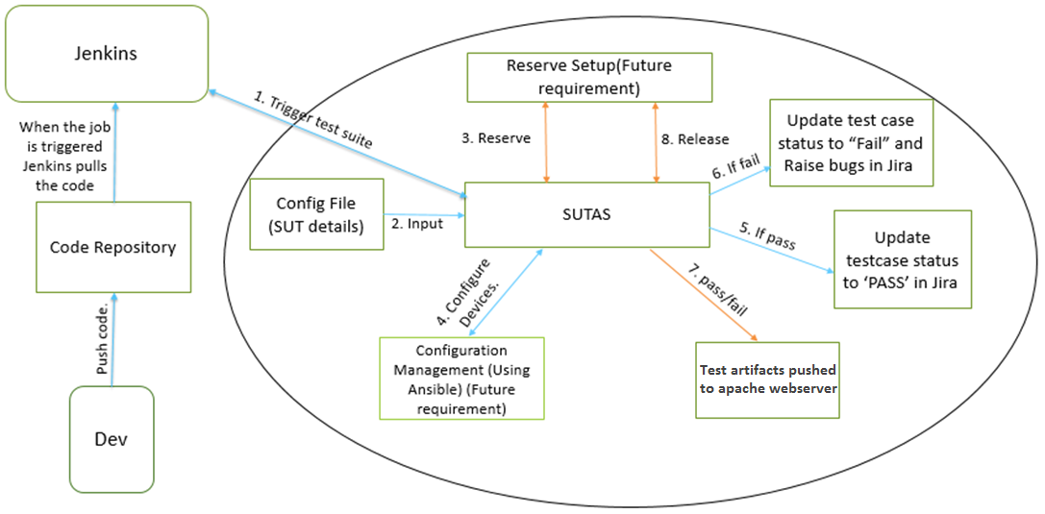
SUTAS Flow Diagram
Notes:
User triggers the tests using Jenkins. Jenkins pulls test libraries and test scripts from repository and execute tests
Inputs to the test will be stored in config file. This config file contains setup details.
SUTAS will reserve the setup (Test Bed Reservation System or TBRS is planned, not in place as yet) as mentioned in config file, before execution starts
Once the setup is reserved, SUTAS calls Configuration Management for configuring the setup.
Test case Execution starts. If pass update the test case status to "PASS" in Jira.
If fail raise bug in Jira and update the test case status to "FAIL" .
Results will be pushed to test artifact repository
Setup will be released (would be accomplished through TBRS) once test is completed

Slide 6
SUTAS Installation
There are 3 ways to install SUTAS and supports only Windows and RHEL 7 platforms.
With internet connection
Without internet connection
SUTAS installation using SUTAS python package
Documents for installing SUTAS can be found in below share point link
With internet connection
https://sungardas.sharepoint.com/teams/ProdTeam/_layouts/15/guestaccess.aspx?guestaccesstoken=ijVdBBSfgzixTcLT2gF4o5OEGuGWB4Tf246ubKUjlVQ%3d&docid=2_1c2d1feed413c4b86ae82e3c0e7f69775&rev=1
Without internet connection
https://sungardas.sharepoint.com/teams/ProdTeam/_layouts/15/guestaccess.aspx?guestaccesstoken=UyHan6pCXuuiniRjoE9AtLVmqUJfRdM9rTR9RQBQQeA%3d&docid=2_12b598fb4e6134942bfd6bd8504925168&rev=1
SUTAS python package
for Windows: https://sungardas.sharepoint.com/teams/ProdTeam/_layouts/15/guestaccess.aspx?guestaccesstoken=nMda7ba9uwV4zw9cmZVOp8P0NDdWBgrlGqo6vcmXB%2bw%3d&docid=2_166fe1f020b2049e2a3f46ee50167bae3&rev=1 For Linux: https://sungardas.sharepoint.com/teams/ProdTeam/_layouts/15/guestaccess.aspx?guestaccesstoken=AOZ2IGDii81srNB4Tzhsfjk5WF4q5iEEJCp1d4n5y9E%3d&docid=2_11fcfff7d89db41369f73dc8e985a22d6&rev=1
Sungard Availability Services Confidential
Notes:
Few machines don’t have access to external URLs. In that case one needs to follow document which is without internet connection.
SUTAS is currently packaged for Windows and Linux (SUTAS is also planned to be made available for Mac in future).
SUTAS packages for Windows and Linux would be placed at a location which is accessible to all in SungardAS.

Slide 7
SUTAS User Setup
First thing user needs to do once SUTAS installation is complete is - to run "sutas user_setup" command
"sutas user_setup" command will ask user for JIRA credentials, JIRA project details, Slack details, email details etc.
"sutas user_setup" will take input values and creates 2 files user_info.yaml and global_conf.yaml file.
All the passwords are stored in user_info.yaml file are encrypted with AES algorithm
Sungard Availability Services Confidential
Notes:
Running "sutas user_setup" command is the first step, user needs to do after one installs SUTAS.
Below are the questions prompted when one runs “sutas user_setup” command:
Enter a key to encrypt/decrypt passwords: User must specify a passphrase here. Using this key SUTAS encrypts/decrypts any password.
Do you want to raise Bugs :(Yes/No) If Yes, then SUTAS will raise bugs for failed test cases. If No, then SUTAS won’t raise any bug when test case fails.
enter Jira username: User must provide JIRA username
enter Jira password: User must provide JIRA password
Enter Jira URL: User must provide JIRA URL.
Enter Jira Project: User must provide JIRA project name in which SUTAS needs to raise bugs.
Enter the Build Version : User must provide the build version on which tests are running.
Enter the Build Environment [test]: User must provide on which environment test are being run(test/production).
By default project lead and test user will be added as watcher Do you want to add more watcher:(Yes/No) If Yes, then it will ask to enter the usernames separated by commas. If No, next prompt occurs.
Enter user name to add as a watcher : If above question’s answer is Yes then it will ask to add watchers. User must enter usernames to be added as watcher, separated by commas
Do you want notifications to Slack Channel [yes]:(Yes/No) If Yes, only then user will receive notification through slack. If No, then user is not notified through slack.
Enter username : User must enter the username by which the slack messages in slack channel must be displayed.
Enter slack channelname : User must enter slack channel name to which notifications need to be sent.
enter Slack token []: User must enter the slack token ID. User can get slack token from https://api.slack.com/custom-integrations/legacy-tokens
Do you want notifications to Email :(Yes/No): If Yes, then user will be notified about the test suite results once execution is done through email. If No, then user will not be notified through email
Enter recipient email-ids separated by comma : User must specify email id's separated by commas.
Enter the log level (info / debug / warn / error) : User must specify log level here. Default log level is info.

Slide 8
Configuration Files
SUTAS uses 3 config files
user_info.yaml
global_conf.yaml
config.yaml
user_info file contain credentials of applications used by SUTAS like JIRA, Slack etc. All the passwords are stored in encrypted format.
global_conf file contains all the other details like Raise Bugs(yes/no), SlackIntegration(yes/no), EmailIntegration(yes/no), JIRA project details, build version, url, watchers, Loglevel, test case management details etc.
config.yaml file contains SUT details.
Sungard Availability Services Confidential
Notes:
When one runs “sutas user_setup” and provides inputs, it will create user_info.yaml and global_conf.yaml files and places them in user’s home directory.
These files must be in users home directory only. SUTAS will read details from these files and execute tests.
User needs to create config.yaml file as below (sample config.yaml file):
netapp: ip: x.x.x.x username: xxxxx password: xxxxx rest_ip: x.x.x.x rest_username: xxxxx rest_password: xxxxx Hitachi: rest_ip: rest_username: rest_password: hitachi_ip: hitachi_username: hitachi_password: Windows_1: ip: username: password: Windows_2: ip: username: password: RHEL_1: ip: username: password: RHEL_2: ip: username: password:
If you want to use these details in test case you just need to use it as below:
To get netapp ip:
${netapp.ip}
To get windows_1 ip, username
${windows_1.ip}
${windows_1.username}

Slide 9
SUTAS integration with JIRA for BUG tracking
Used Jira-Python library to communicate with JIRA
SUTAS raises bugs using below summary and description formats. Summary: <Test Case Name> failed with error <Error MSG> Description: Test suite name: <Test Suite Name> Test case name: <Test Case Name> <Test failed at keyword> <Error msg>
Raising new bugs versus incrementing hit count versus re-opening bugs
Sungard Availability Services Confidential
Notes:
SUTAS forms summary and description in above mentioned format and raises bug.

Slide 10
SUTAS Integration with JIRA for BUG Tracking
SUTAS attaches the log file of that particular test case which failed.
SUTAS checks if duplicate bug already exists or not before raising one. If duplicate bug already exists and is in open state, then updates the hit count
Hit count: A hitcount field contains numeric value which represents the number of times the bug occurred.
If duplicate bug already exists (in the same release version) and is in closed state, then SUTAS reopens it.
Notes:
SUTAS also checks for duplicate bugs. If duplicate exists then it will check if it is closed state or open state.
If it is in closed state then SUTAS will re-open that bug, attaches latest logs and comments.
If it is in open state then SUTAS will increment the hitcount in JIRA, attaches latest logs and comments.
Please note that ‘hitcount’ field is not available with default JIRA installation. This field needs to be created in JIRA by JIRA admin before creating and executing tests through SUTAS.

Slide 11
Fields populated by SUTAS while raising bugs
Fields | Description
Summary | Summary in below format. <Test Case Name> failed with error <Error MSG>
Description | Description Format: Test suite name: <Test Suite Name> Test case name: <Test Case Name> <Test failed at keyword> <Error msg> In addition, statement “Please check attached log for more information” will be added by SUTAS
Issue Type | ‘BUG’
Priority | By default, it would be P2 High
Affects Version | Will be fetched from user_info file.
Components | Will be fetched from Jira for the failed test case. If component is not mentioned for a test case in Jira, then “Components” would be populated as ‘Unspecified’
Labels | Will be fetched from Jira for the failed test case. If label is not mentioned for a test case in Jira, then “Labels” would be populated as ‘Unspecified’
Environment Type | Will be fetched from user_info file
Assignee | By default, it will be ‘automatic’ or ‘unassigned’
Attachments | Logs will be attached.
Comments | SUTAS will be able to add comments such ‘hitcount increased to …” or ‘Please check attached logs for more information’ or ‘Reopening bug ….’ etc..
Notes:
These are the fields populated by SUTAS while raising a bug.

Slide 12
Test Management in JIRA
What fields are required for Testsuite and test case are listed in below link. Also it mentions about different workflows for test suite and test cases.
https://sungardas.sharepoint.com/teams/ProdTeam/_layouts/15/guestaccess.aspx?guestaccesstoken=yGMqDhl4%2bcTkTUl%2b6L6qWvxQyCxH5kl4eGNJ3cFscEM%3d&docid=2_1cddc2c05cc7e4ed98e76fa93eaf9e0b0&rev=1
In test case, one needs to specify "sutas-id". This field contains unique value, which will be used while automating test cases through RIDE.
https://sungardas.sharepoint.com/teams/ProdTeam/_layouts/15/guestaccess.aspx?guestaccesstoken=1DYbF%2fqa72G8Hox%2bOYhvFjux17bS9xaD7ndxkJupnSA%3d&docid=2_1349cf9e3d4c44e3899598d4f7e86307c&rev=1
Depending on test case management keys mentioned in global config file, SUTAS will clone the master suite.
Once the execution starts SUTAS moves all the test cases to “running” state and when execution is done it will move to PASS/FAIL
SUTAS also links bug id to the failed test case
Notes:
SUTAS does test management in JIRA.

Slide 13
Build Integration
SUTAS runs are triggered via Jenkins, and on demand
The suite(s) of tests run are determined by label directives
Presently we have been focusing on Must Pass Test Suites, which run after builds
All tests that carry a configuration label “MPTC” are automatically run
Similarly we can trigger “Regression”, “Negative”, “Performance”, “Release” and so forth

Slide 14
Slack Integration
SUTAS sends start/completion notifications to a specified slack channel
Slack authentication is done through a TOKEN
TOKEN needs to be provided by user
One can get tokens from below link https://api.slack.com/custom-integrations/legacy-tokens (One has to login with one’s credentials)
Similarly, SUTAS integrates with Microsoft Teams
Notes:
SUTAS fetches slack channel and tokens details from user_info.yaml and global_conf.yaml files and sends notification.

Slide 15
Email Integration
An Email notification is sent when test suite execution is complete
SUTAS uses SMTP relay service for sending email
Email recipients’ list has to be provided by user in Global config file

Slide 16
Test Artifacts
SUTAS pushes test result logs in to Apache Webserver
SUTAS will consolidate all the logs and makes it a tar, when test suite execution is completed. The tar ball name contains the time stamp
This tar ball is then pushed to apache webserver
Moving forward we plan to switch to Nexus as our repository
Complete test details and results are sent to a central Postgress instance
The instance can be queried through SQL and through Tableau

Slide 17
Test Case Dependency
While automating test cases, user needs to specify “depends” variable for declaring the dependency of one test case(s) over other(s), and send it to setup instance.
Test cases in the test suite must be ordered as per their dependency, for SUTAS to execute this suite.
If the test cases are in correct order following the dependency, SUTAS would start execution.
If the test cases are not in order following the dependency, SUTAS would not start execution.
Notes:
SUTAS doesn’t take care of dependency.
User must take care of dependency order while automating test cases using RIDE.
Before execution is started, SUTAS will check if test cases are ordered as per their dependency.
For instance: In case of TC1, TC2, TC3, if TC2 is dependent on TC1, then the expected order of test cases for SUTAS to start execution is TC2, TC1, TC3.
If SUTAS finds the test cases in any other order (for example – TC1, TC2, TC3), it doesn’t start the execution…. observing that TC1 can not be started because TC2 is not executed as yet in the current execution cycle.

Slide 18
How to Automate Test Cases using RIDE
Using RIDE users can easily automate test cases. Below link has document which gives step by step procedure on creating test cases. https://sungardas.sharepoint.com/teams/ProdTeam/_layouts/15/guestaccess.aspx?guestaccesstoken=1DYbF%2fqa72G8Hox%2bOYhvFjux17bS9xaD7ndxkJupnSA%3d&docid=2_1349cf9e3d4c44e3899598d4f7e86307c&rev=1
There are few mandatory steps which needs to be done while automating test cases.
User must specify software/hardware requirements as one dictionary variable and test case dependency and send that to setup. &{test_aggregate_creation} = {'windows':'IOmeter', 'Linux':'VDBench'} this variable must be passed to setup in RIDE. setup.Run | depends=test case1,test case2 | &{test_aggregate_creation}
Also user must run Teardown.Run in teardown field
Notes:
“Automating test cases using RIDE” documentation explains step by step procedure - with screenshots.

Slide 19
References
SUTAS High Level Design Document
https://sungardas.sharepoint.com/teams/ProdTeam/_layouts/15/guestaccess.aspx?guestaccesstoken=3Enldbs8mBmoeXmLdj89G16aIOoL%2bbwtWhtYRVUL6Ew%3d&docid=2_10f36181d55f34757bfee259f967d76ca&rev=1
Creating test suites using RIDE
https://sungardas.sharepoint.com/teams/ProdTeam/_layouts/15/guestaccess.aspx?guestaccesstoken=1DYbF%2fqa72G8Hox%2bOYhvFjux17bS9xaD7ndxkJupnSA%3d&docid=2_1349cf9e3d4c44e3899598d4f7e86307c&rev=1
Creating libraries for SUTAS
https://sungardas.sharepoint.com/teams/ss/Shared%20Documents/TestAutomation/SUTAS/Create%20SUTAS%20libraries.docx?d=wab041630c5e947f3aadc7ce39318cc90
Test case management in JIRA
https://sungardas.sharepoint.com/teams/ProdTeam/_layouts/15/guestaccess.aspx?guestaccesstoken=yGMqDhl4%2bcTkTUl%2b6L6qWvxQyCxH5kl4eGNJ3cFscEM%3d&docid=2_1cddc2c05cc7e4ed98e76fa93eaf9e0b0&rev=1
Wiki pages related to SUTAS
https://mountdiablo.jira.com/wiki/pages/viewpage.action?pageId=228443672

Slide 20
Thank You

Slide 21
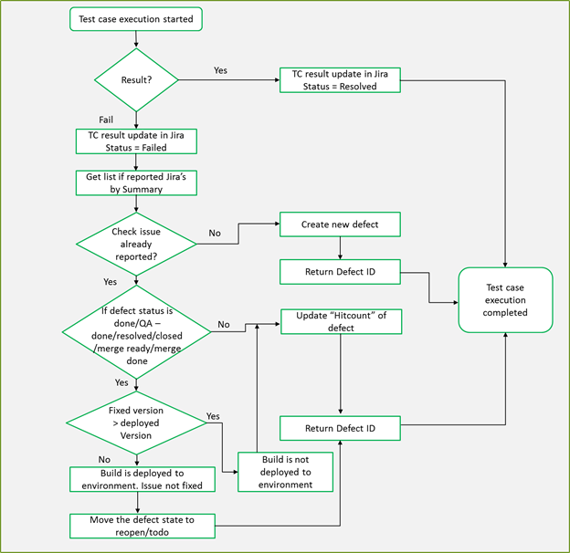
Flow for Managing bugs
Notes:
SUTAS follows above workflow for test management and bug management

